Slide 1
THE exclusivity of Christ in our pluralistic world Dr. Adam Harwood Associate Professor of Theology NOBTS

Slide 2
Do all paths lead to God?

Slide 3
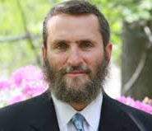
“I am absolutely against any religion that says that one faith is superior to another. I don’t see how that is anything different than spiritual racism. It’s a way of saying that we are closer to God than you, and that’s what leads to hatred.” – Rabbi Shmuley Boteach, Larry King Live, 2000

Slide 4
“Are we to believe that only Christians are right?” – Charles Templeton, Farewell to God, 27.

Slide 5
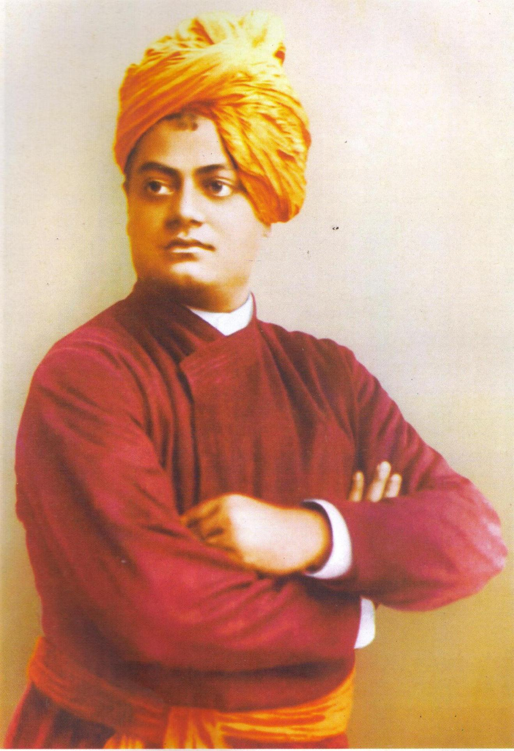
“We [Hindus] accept all religions to be true.” – Swami Vivekananda to the World Parliament of Religions (1893).

Slide 6
Is it close-minded or arrogant to say that faith in Christ is the only way to be in a right relationship with God?

Slide 7
Proposed answer
Perhaps all religions are true and all paths lead to God.

Slide 8
evaluation
World religions make exclusive claims.

Slide 9
World religions make exclusive claims.
Muslims claim theological and linguistic exclusivity. They claim the sole and sufficient miracle of Islam is the Koran (in Arabic).

Slide 10
World religions make exclusive claims.
Buddhists reject two fundamentals of Hinduism, their Scriptures (the Vedas) and the caste system.

Slide 11
World religions make exclusive claims.
Hindus affirm the law of Karma, the authority of the Vedas, and the concept of reincarnation.

Slide 12
World religions make exclusive claims.
All truth, by definition, is exclusive.
All truth claims exclude its opposite.

Slide 13
Quiz: What is the Goal of this sport?

Slide 14
Quiz: What is the Goal of this sport?

Slide 15
Quiz: What is the Goal of this sport?

Slide 16
Quiz: What is the Goal of this sport?

Slide 17
Goals of various sports
Baseball | Higher points via runs
Soccer | Higher points via goals
Football | Higher points via touchdowns or field goals
Basketball | Higher points via baskets
Golf | Lower score via strokes
Tennis | Higher score via points
Hockey | Higher score via goals
Chess | Place opponent into checkmate

Slide 18
evaluation
World religions make exclusive claims.
World religions have different goals.

Slide 19
Goals of world religions
Islam | Submission
Christianity | Salvation
Confucianism | Propriety
Hinduism | Devotion
Buddhism | Awakening
Yoruba Religion | Connection
Judaism | Returning
Daoism | Flourishing
- Stephen Prothero, God is Not One: The Eight Rival Religions that Run the World (HarperOne, 2010)

Slide 20
evaluation
World religions make exclusive claims.
World religions have different goals.
World religions affirm various views about god(s).

Slide 21
Views of god(s)
Islam | Affirms one god, Allah; denies the Trinity
Christianity | Affirms a holy, creator, Triune, redeemer God
Confucianism | No doctrine of god(s)
Hinduism | 300 million gods, but most important are Brahma, Vishnu & Shiva
Buddhism | Denies existence of a creator, sustainer & judge
Yoruba Religion | Affirms Olodumare as the chief source of power, among other lesser gods
Judaism | Affirms one god, YHWH; denies the Trinity
Daoism | Affirms a hierarchy of gods who help people if worshipped properly
- Winfried Corduan, Pocket Guide to World Religions (IVP, 2006)

Slide 22
evaluation
World religions make exclusive claims.
World religions have different goals.
World religions affirm various views about god(s).
Jesus Christ is unique in world history.

Slide 23
Jesus was/is fully human and fully divine.

Slide 24
Romans 1:1-4
Paul, a servant of Christ Jesus, called to be an apostle and set apart for the gospel of God—the gospel he promised beforehand through his prophets in the Holy Scriptures regarding his Son, who as to his earthly life was a descendant of David, and who through the Spirit of holiness was appointed the Son of God in power by his resurrection from the dead: Jesus Christ our Lord.

Slide 25
Jesus’ birth was foretold centuries earlier by Old Testament prophets.

Slide 26
Isaiah 7:14
Therefore the Lord himself will give you a sign: The virgin will conceive and give birth to a son, and will call him Immanuel. (See Matt 1:22-23)

Slide 27
Micah 5:2
But you, Bethlehem Ephrathah, though you are small among the clans of Judah, out of you will come for me one who will be ruler over Israel, whose origins are from of old, from ancient times.
(See Luke 2:4-7)

Slide 28
Jesus was sinless.

Slide 29
Hebrews 4:15
For we do not have a high priest who is unable to sympathize with our weaknesses, but one who in every respect has been tempted as we are, yet without sin.

Slide 30
Jesus is/was God.

Slide 31
The divinity of Jesus - HANDS
Jesus was honored and worshiped in ways appropriate only for God (Matt 2:2, 11; 9:18; John 5:23; 14:14).

Slide 32
John 20:28
Thomas responded to Jesus, “My Lord and my God!”

Slide 33
The divinity of Jesus - HANDS
Attributes were predicated to Jesus that are appropriate only to God (uncreated, John 1:1–3; believing and looking at Jesus is like believing and looking at the One who sent him, John 12:44–45).

Slide 34
John 12:44–45
Then Jesus cried out, “Whoever believes in me does not believe in me only, but in the one who sent me. The one who looks at me is seeing the one who sent me.”

Slide 35
The divinity of Jesus - HANDS
Jesus shared in the names of God (Savior, Christ, the Lord, Luke 2:11; the “I Am” sayings in the Gospel of John).

Slide 36
The titles of Jesus—Messiah
“Messiah” (or “Christ”) literally means the “anointed one.”
Jews expected the Messiah to be their deliverer.
Jesus affirmed Peter’s declaration that Jesus is the Messiah (Matt 16:16-17).

Slide 37
The titles of Jesus—LORD
“Lord” (kurios) has two uses in the NT:
a title of respect (“sir,” “Mr.”)
a divine being (as Jews translated the Hebrew YHWH as kurios in the Greek translation of the OT)

Slide 38
The titles of Jesus
In Acts 2:36, Peter said:
“Therefore let all Israel be assured of this: God has made this Jesus, whom you crucified, both Lord and Messiah.”

Slide 39
The titles of Jesus— SON OF GOD
The title “Son of God” signifies Jesus’ unique relationship with God the Father. When Jesus died, the Centurion declared, “Surely this man was the Son of God!” (Mark 15:39).

Slide 40
The titles of Jesus— SON OF MAN
In Daniel 7, the Son of Man descends on the clouds and is authorized by God to judge the nations. During his trial, Jesus identified himself as the “Son of Man sitting at the right hand of the Mighty One and coming on the clouds of heaven” (Mark 14:62).

Slide 41
The divinity of Jesus - HANDS
Affirmed by his deeds. Jesus acted in ways only God can act (forgiving sin, Mark 2:1–12; sending the Holy Spirit, Luke 24:49).

Slide 42
Jesus Forgives Sins
And behold, they were bringing to Him a paralytic, lying on a bed; and Jesus seeing their faith said to the paralytic, “Take courage, my son, your sins are forgiven.” And behold, some of the scribes said to themselves, “This fellow blasphemes.”

Slide 43
Jesus Forgives Sins
And Jesus knowing their thoughts said, “Why are you thinking evil in your hearts? For which is easier, to say, “Your sins are forgiven,” or to say, “Rise and walk?” But in order that you may know that the Son of Man has authority on earth to forgive sins—then He spoke to the paralytic—“Rise, take up your bed, and go home.”

Slide 44
Jesus Forgives Sins
And he rose, and went home. But when the multitudes saw this, they were filled with awe, and glorified God, who had given such authority to men.
- Matthew 9:1-8

Slide 45
Jesus as the only Means to Salvation
Jesus said to him, “I am the way, and the truth, and the life; no one comes to the Father but through Me.”
- John 14:6

Slide 46
The divinity of Jesus - HANDS
Jesus shares God’s seat. Jesus claims a divine position (all authority has been given to him, Matt 28:18; at God’s right hand and serving as divine judge, Mark 14:61–64).

Slide 47
Matt 28:18
Then Jesus came to them and said, “All authority in heaven and on earth has been given to me.”

Slide 48
evaluation
World religions make exclusive claims.
World religions have different goals.
World religions affirm various views about god(s).
Jesus Christ is unique in world history.
Faith in Christ is the only hope the NT offers that people can be right with God.

Slide 49
Romans 10:9-10
If you confess with your mouth, “Jesus is Lord,” and believe in your heart that God raised him from the dead, you will be saved. For it is with your heart that you believe and are justified, and it is with your mouth that you confess and are saved.

Slide 50
John 14:6
Jesus said to him, “I am the way, and the truth, and the life; no one comes to the Father but through Me.”

Slide 51
evaluation
World religions make exclusive claims.
World religions have different goals.
World religions affirm various views about god(s).
Jesus Christ is unique in world history.
Faith in Christ is the only hope the NT offers that people can be right with God.

Slide 52
THE exclusivity of Christ in our pluralistic world Dr. Adam Harwood Associate Professor of Theology NOBTS

